Slide 1
Cryptography and Network Security
Third Edition
by William Stallings
Lecture slides by Lawrie Brown

Slide 2
Chapter 7 – Confidentiality Using
Symmetric Encryption
John wrote the letters of the alphabet under the letters in its first lines and tried it against the message. Immediately he knew that once more he had broken the code. It was extraordinary the feeling of triumph he had. He felt on top of the world. For not only had he done it, had he broken the July code, but he now had the key to every future coded message, since instructions as to the source of the next one must of necessity appear in the current one at the end of each month.
  —Talking to Strange Men, Ruth Rendell

Slide 3
Confidentiality using Symmetric Encryption
traditionally symmetric encryption is used to provide message confidentiality
consider typical scenario
  workstations on LANs access other workstations & servers on LAN
  LANs interconnected using switches/routers
  with external lines or radio/satellite links
consider attacks and placement in this scenario
  snooping from another workstation
  use dial-in to LAN or server to snoop
  use external router link to enter & snoop
  monitor and/or modify traffic one external links
Notes:
Have many locations where attacks can occur in typical scenarios.

Slide 4
Confidentiality using Symmetric Encryption
have two major placement alternatives
link encryption
  encryption occurs independently on every link
  implies must decrypt traffic between links
  requires many devices, but paired keys
end-to-end encryption
  encryption occurs between original source and final destination
  need devices at each end with shared keys

Slide 5
Traffic Analysis
when using end-to-end encryption must leave headers in clear
  so network can correctly route information
hence although contents protected, traffic pattern flows are not
ideally want both at once
  end-to-end protects data contents over entire path and provides authentication
  link protects traffic flows from monitoring

Slide 6
Placement of Encryption
can place encryption function at various layers in OSI Reference Model
  link encryption occurs at layers 1 or 2
  end-to-end can occur at layers 3, 4, 6, 7
  as move higher less information is encrypted but it is more secure though more complex with more entities and keys

Slide 7
Traffic Analysis
is monitoring of communications flows between parties
  useful both in military & commercial spheres
  can also be used to create a covert channel
link encryption obscures header details
  but overall traffic volumes in networks and at end-points is still visible
traffic padding can further obscure flows
  but at cost of continuous traffic

Slide 8
Key Distribution
symmetric schemes require both parties to share a common secret key
issue is how to securely distribute this key
often secure system failure due to a break in the key distribution scheme
Notes:
This is one of the most critical areas in security systems - on many occasions systems have been broken, not because of a poor encryption algorithm, but because of poor key selection or management. It is absolutely critical to get this right!

Slide 9
Key Distribution
given parties A and B have various key distribution alternatives:
  A can select key and physically deliver to B
  third party can select & deliver key to A & B
  if A & B have communicated previously can use previous key to encrypt a new key
  if A & B have secure communications with a third party C, C can relay key between A & B
Notes:
Physical delivery (1 & 2) is simplest - but only applicable when there is personal contact between recipient and key issuer. Is fine for link encryption where devices & keys occur in pairs, but does not scale as number of parties who wish to communicate grows.
A third party is a trusted intermediary, whom all parties trust, to mediate the establishment of secure communications between them. Must trust intermediary not to abuse the knowledge of all session keys.
As number of parties grow, some variant of 4 is only practical solution.

Slide 10
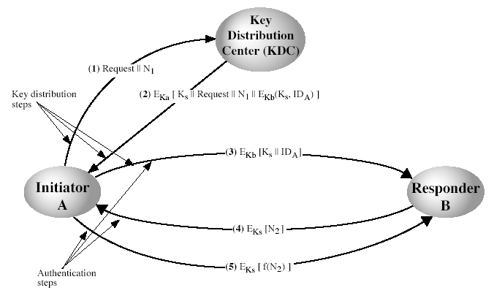
Key Distribution Scenario
Notes:
Stallings Fig 7.9.
Based on concept of having a “Key Distribution Center” (KDC) which shares a unique key with each party (user).
See text for details of steps in distribution process.

Slide 11
Key Distribution Issues
hierarchies of KDC’s required for large networks, but must trust each other
session key lifetimes should be limited for greater security
use of automatic key distribution on behalf of users, but must trust system
use of decentralized key distribution
controlling purposes keys are used for

Slide 12
Random Numbers
many uses of random numbers in cryptography
  nonces in authentication protocols to prevent replay
  session keys
  public key generation
  keystream for a one-time pad
in all cases its critical that these values be
  statistically random
    with uniform distribution, independent
  unpredictable cannot infer future sequence on previous values
Notes:
Getting good random numbers is important, but difficult. You don't want someone guessing the key you're using to protect your communications because your "random numbers" weren't (as happened in an early release of Netscape SSL).
Although have well-defined tests for determining that a sequence of numbers match uniform distribution, there is no such test to "prove“ independence. Rather, use a number of tests to demonstrate that a sequence does not
exhibit independence, until the confidence that independence exists is sufficiently strong.
Since often use pseudo-random number, must ensure cannot predict future elements of sequence on basis of
earlier elements.

Slide 13
Natural Random Noise
best source is natural randomness in real world
find a regular but random event and monitor
do generally need special h/w to do this
  eg. radiation counters, radio noise, audio noise, thermal noise in diodes, leaky capacitors, mercury discharge tubes etc
starting to see such h/w in new CPU's
problems of bias or uneven distribution in signal
  have to compensate for this when sample and use
  best to only use a few noisiest bits from each sample

Slide 14
Published Sources
a few published collections of random numbers
Rand Co, in 1955, published 1 million numbers
  generated using an electronic roulette wheel
  has been used in some cipher designs cf Khafre
earlier Tippett in 1927 published a collection
issues are that:
  these are limited
  too well-known for most uses

Slide 15
Pseudorandom Number Generators (PRNGs)
algorithmic technique to create “random numbers”
  although not truly random
  can pass many tests of “randomness”

Slide 16
Linear Congruential
Generator
common iterative technique using:
  X_{n+1} = (aX_{n} + c) mod m
given suitable values of parameters can produce a long random-like sequence
suitable criteria to have are:
  function generates a full-period
  generated sequence should appear random
  efficient implementation with 32-bit arithmetic
note that an attacker can reconstruct sequence given a small number of values

Slide 17
Using Block Ciphers as Stream Ciphers
can use block cipher to generate numbers
use Counter Mode
  X_{i} = E_{Km}[i]
use Output Feedback Mode
  X_{i} = E_{Km}[X_{i-1}]
ANSI X9.17 PRNG
  uses date-time + seed inputs and 3 triple-DES encryptions to generate new seed & random

Slide 18
Blum Blum Shub Generator
based on public key algorithms
use least significant bit from iterative equation:
  x_{i+1} = x_{i}² mod n
  where n=p.q, and primes p,q=3 mod 4
unpredictable, passes next-bit test
security rests on difficulty of factoring N
is unpredictable given any run of bits
slow, since very large numbers must be used
too slow for cipher use, good for key generation

Slide 19
Summary
have considered:
  use of symmetric encryption to protect confidentiality
  need for good key distribution
  use of trusted third party KDC’s
  random number generation

